Slide 1

Unsupervised Geometric Learning:
Theory and Applications
James M. Murphy
Department of Mathematics
Johns Hopkins University

Slide 2
Outline
Overview of Data Science and Unsupervised Learning
Spectral Clustering with Data-Dependent Metrics
Spatial-Spectral Clustering of Hyperspectral Images

Slide 3
Outline
Overview of Data Science and Unsupervised Learning
Spectral Clustering with Data-Dependent Metrics
Spatial-Spectral Clustering of Hyperspectral Images

Slide 4


Data Science Revolution?
The Economist, 2010
The New Yorker, 2017

Slide 5
A Simplified Picture
Some Major Advances:
Image segmentation
Melanoma detection
Topic analysis of text documents
Anamoly detection in remote sensing images
Identifying gerrymandering
Crime mapping & prediction
Some Mathematical Questions:
Performance guarantees: When do algorithms and heuristics have theoretical justification?
Statistical learning theory: How is machine learning different from classical approximation theory?
Fast, scalable algorithms: Can structure in complicated data be exploited to design efficient algorithms?
Science & Engineering (empirical)
Mathematics, Statistics, & Computer Science (theoretical)
Data Science

Slide 6

Unsupervised Learning
Unsupervised learning: infer structure from data without access to training data, i.e. examples belonging to particular classes.
Clustering: unsupervised learning in which the goal is to label points as belonging to a given class.
Labeling: Which were generated from ?
Number of Clusters: Can we estimate ?

Slide 7

Standard Method: K-Means
Idea: find centroids, then assign each point to its nearest centroid.
Empirically good for same sized, spherical clusters.
Guaranteed for certain Gaussians.
Exact solution is NP-Hard to compute.
Standard implementations involve non-convex optimization.
Need to know .

Slide 8
Standard Method: K-Means
Idea: find centroids, then assign each point to its nearest centroid.
Empirically good for same sized, spherical clusters.
Guaranteed for certain Gaussians.
Exact solution is NP-Hard to compute.
Standard implementations involve non-convex optimization.
Need to know .

Slide 9
K-Means Often Fails
Problem: Some clusters are non-spherical!
A. Ng, M. Jordan, and Y. Weiss. "On spectral clustering: Analysis and an algorithm." Advances in neural information processing systems. 2002.

Slide 10
How to Improve?
The inability of K-means to handle nonlinear, elongated data is problematic, both theoretically and practically.
We present a classical method for handling such data, and propose a related method that enjoys robust performance guarantees, efficient implementation, and strong empirical performance.
The issue of the non-convexity of the K-means functional is an open research topic in optimization (not in this talk, but interesting).

Slide 11
Outline
Overview of Data Science and Unsupervised Learning
Spectral Clustering with Data-Dependent Metrics
Spatial-Spectral Clustering of Hyperspectral Images

Slide 12




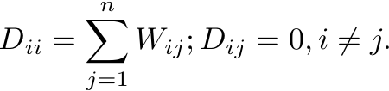
Spectral Clustering I
Idea: embed data into a lower-dimensional space in a structure preserving way.
Input:
Step 1: Build a weight matrix
for some metric and .
Step 2: Compute the (graph) Laplacian
U. Von Luxburg. “A tutorial on spectral clustering”. Statistics and Computing. 2007. 17(4):395-416.

Slide 13




Spectral Clustering II
Step 3: Compute eigenvalues of
and associated eigenvectors
Step 4: Embed the data as
then run K-means. Note
Parameter Problems:
Dependence on parameters
Heuristic:

Slide 14
K-Means v. Spectral Clustering
Spectral clustering (with a “good” ) succeeds where K-means fails!
Theoretical estimates are limited, particularly for estimating the number of clusters . Weak guarantees for elongated clusters.

Slide 15
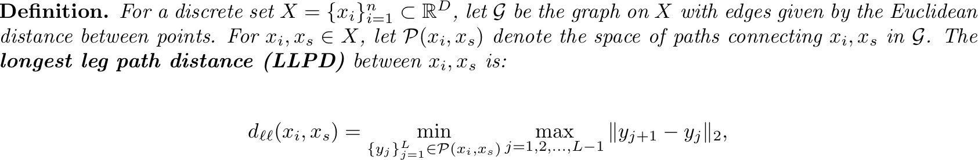
Data-Dependent LLPD Metric
The distance between points is the minimum over all paths between of the longest edge in the path.
Depending on the data , this distance changes!
We are re-shaping the unit ball to respect the geometry of the data.
could be a complete graph (all points connected to all points) or a connected NN graph.
Looks hard to compute. We will present a fast approximation algorithm.

Slide 16
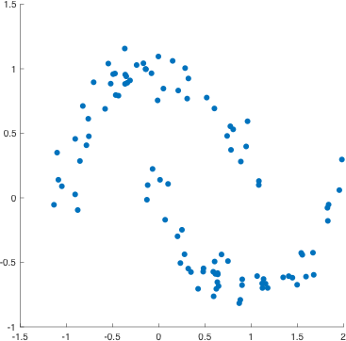
LLPD Visualization
The green and red paths both connect the specified points, but the red path has smaller maximal edge length.

Slide 17
Euclidean Distance versus LLPD

Slide 18
Data Well-Suited for LLPD

Slide 19
LLPD Weight Matrix
For our simple “four lines” data, there is a big difference between Euclidean distance (data independent) and LLPD (data dependent).
The LLPD weight matrix has block-constant structure.

Slide 20

Curse of Dimensionality and a Manifold Cure
A major difficulty to clustering in high dimensions is the curse of dimensionality.
Namely, uniformly sampled points in have average nearest neighbor distance .
These large distances make everything look far apart in high dimensions.
To make learning tractable, we assume that high dimensional data enjoys intrinsically low dimensional structure.
This allows to circumvent the curse of dimensionality if the intrinsic dimension is small enough!

Slide 21
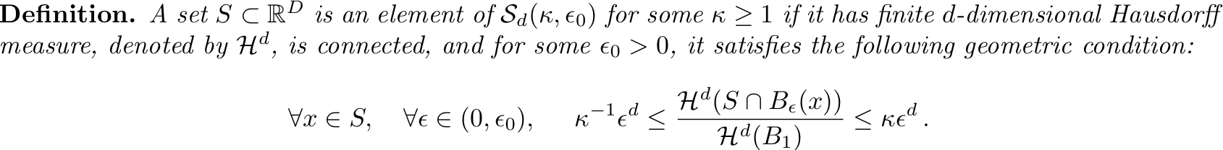




Low Dimensional, Large Noise (LDLN) Model
Low-dimensional
Large noise

Slide 22

Nearest Neighbors in LLPD and Denoising
In the LDLN model, points within clusters all have comparable distances, and points from different clusters are well separated.
Noise points can be provable identified by considering distances to their LLPD nearest neighbor.
We denoise according to a parameter by examining the distance to the LLPD nearest neighbor.
This analysis, based on percolation theory, proves the weight matrix is nearly block constant.

Slide 23
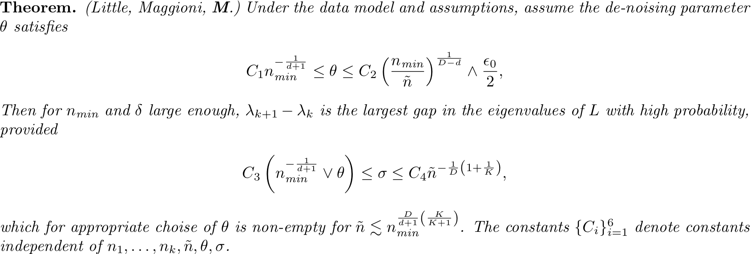

Eigengap Guarantee
“With high probability” quantifies the fact that the data model is stochastic.
If , then our method correctly determines the number of clusters, even the presence of huge amounts of noise.
As , the amount of noise that can be tolerated is exponential compared to the number of cluster points, with exponent .
Few comparable results for Euclidean spectral clustering.
A. Little, M. Maggioni, and J.M. Murphy. “Path-Based Spectral Clustering: Guarantees, Robustness to Outliers, and Fast Algorithms”. ArXiv preprint. 2017

Slide 24
Synthetic Data

Slide 25
Synthetic Data Eigengap
For elongated data, only LLPD spectral clustering has an accurate eigengap.

Slide 26
Synthetic Data Eigengap
For elongated data, only LLPD spectral clustering has an accurate eigengap.

Slide 27

Real Data: DrivFaces
Faces of four drivers, 2 male and 2 female.
https://archive.ics.uci.edu/ml/datasets/DrivFace

Slide 28
EigenGap DrivFaces
LLPD spectral gap correctly estimates number of clusters for a wide range, while Euclidean spectral clustering fails for all .
100% accuracy of labeling with LLPD spectral clustering.

Slide 29
EigenGap DrivFaces
LLPD spectral gap correctly estimates number of clusters for a wide range, while Euclidean spectral clustering fails for all .
100% accuracy of labeling with LLPD spectral clustering.

Slide 30
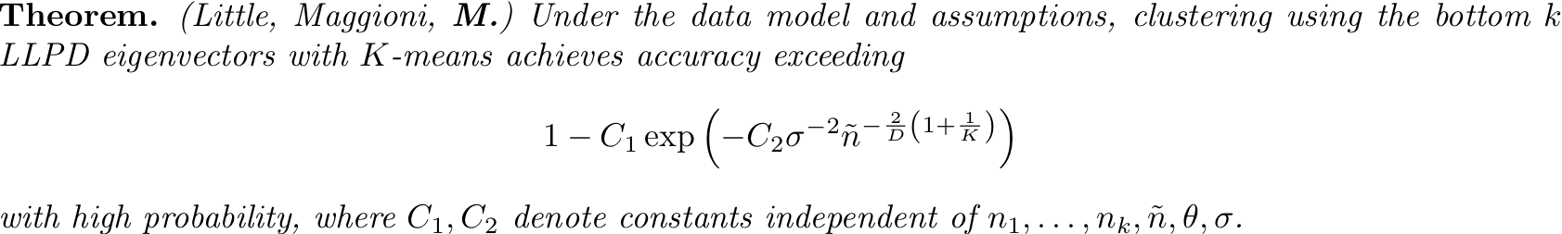

Clustering Accuracy Guarantees
Good accuracy for clustering, depending on .
Qualitatively similar results are known for Euclidean spectral clustering, but with inferior bounds, owing to the variation of distances within a cluster.
Our method enjoys robustness to cluster shape, and hence our accuracy estimates are superior.

Slide 31



Numerical Implementation
Recall computation appears hard, since space of paths is large.
Efficient approximation scheme, quasilinear in .
Precisely, computing all point’s LLPD neighbors is
is the number of neighbors in original graph.
is related to accuracy of approximation.
is the cost of a Euclidean nearest neighbor query.
Big data regime ( takes a few minutes! )

Slide 32
Future Work with LLPD Spectral Clustering
Asymptotic consistency as ; what does the corresponding continuum problem look like? What is the relationship between the eigenvectors of the PDE with the eigenvectors of the (discrete) graph Laplacian?
Exact LLPD computation using Cartesian trees with same computational complexity. Theoretically possible, not clear how to implement.
Applications to large, high dimensional datasets such as remote sensing and biomedical data.

Slide 33
Outline
Overview of Data Science and Unsupervised Learning
Spectral Clustering with Data-Dependent Metrics
Spatial-Spectral Clustering of Hyperspectral Images

Slide 34
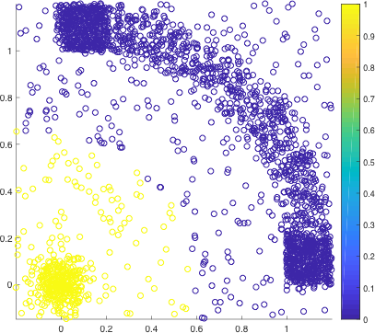
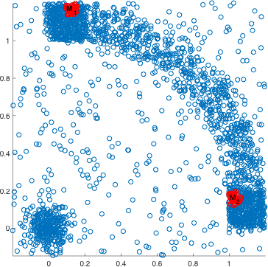
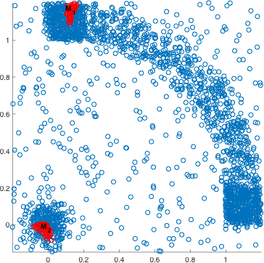
Multimodal Distributions
What if density is not approximately constant?
What if a single cluster has multiple regions of high density, i.e. is multimodal?
Mode detection: how to find unique modes from each cluster?
An unsupervised learning algorithm should be invariant to both distribution shape and multimodality.
Bad
Good

Slide 35


Multimodal Classes: Hyperspectral Images (HSI)
High dimensional images:
The spectral bands are localized at certain electromagnetic frequencies, allowing for precise differentiation of materials in scenes
Learning Problems: clustering, anomaly detection, active learning, classification, segmentation, compression…
Applications: land cover change, water quality evaluation, precision agriculture, pollution tracking, defense and security…
Spatial Spectral
Subset of Pavia dataset, sum of all bands (sum across )
Ground Truth
http://www.ehu.eus/ccwintco/index.phptitle=Hyperspectral_Remote_Sensing_Scenes

Slide 36
Each Pixel is a High-Dimensional Vector
Large within class variation.
Significant between-class overlap in some dimensions.

Slide 37
Individual Spectral Bands
Band 2
Band 20
Band 40
Band 102

Slide 38
Obstructions to Learning HSI
High ambient dimension: Pavia dataset has 102 spectral bands—others over 200!
Nonlinear spectral structure: Bands capture different material properties, and do not correlate with each other linearly.
Large numbers of pixels: Images can easily exceed in spatial size. Combined with the spectral dimension, this data is quite big.
Noise: HSI are prone to noise from a variety of settings, which may affect some dimensions differently than others.
High-dimensional, big data regime

Slide 39
Redeeming Properties
Intrinsically low-dimensional: while the number of spectral bands is high ( ), a lower dimensional ( ) representation may be feasible.
Manifold structure: though nonlinear, the spectra may lie near a
(low-dimensional) manifold characterized by the intrinsic properties of the materials in the scene.
High-dimensional noise: the noise may be understood as additive in the bands, and thus is amenable to robust methods.
Joint spatial-spectral information: the arrangement of pixels for each band is consistent, which introduces spatial regularity that can be exploited.
Robust, nonlinear statistical learning

Slide 40




Diffusion Maps: Capturing Intrinsic Geometry of Data
Construct a weighted graph on
Generate a Markov process:
Compute distances based on diffusion with respect to :
has spectral decomposition
Support of Weight matrix
R.R. Coifman, S. Lafon, A.B. Lee, M. Maggioni, B. Nadler, F. Warner, and S.W. Zucker. ”Geometric diffusions as a tool for harmonic analysis and structure definition of data: Diffusion maps." PNAS 102.21 (2005): 7426-7431.

Slide 41
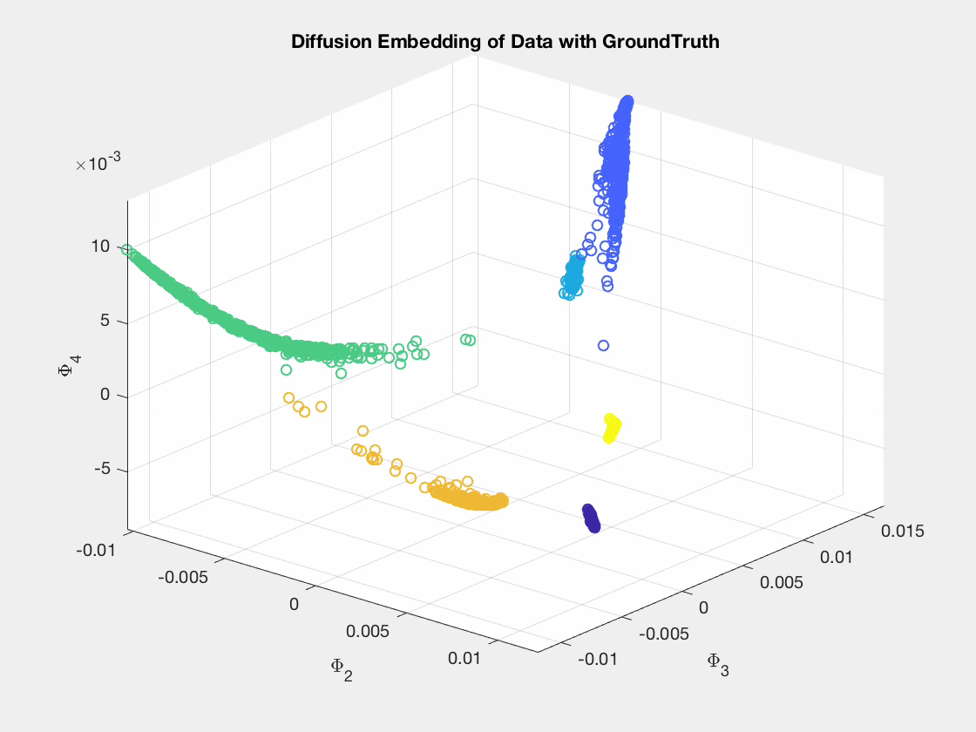
Exploiting Nonlinear Structure: Diffusion Maps

Slide 42
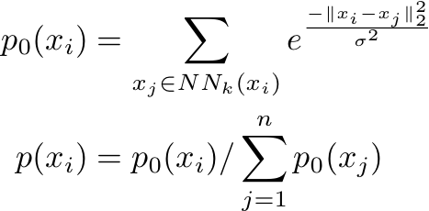
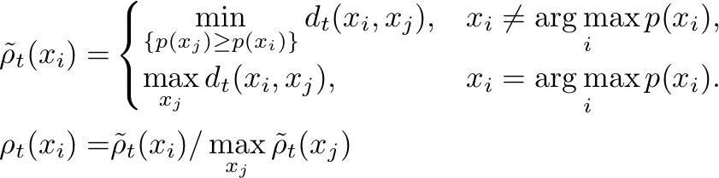

Mode Estimation
1.) Compute empirical density:
2.) Find points that are -far from higher density points:
3.) Estimate modes as maximizers of:
J.M. Murphy and M. Maggioni. “Nonlinear Unsupervised Clustering of Hyperspectral Images, with Applications to Anomaly Detection and Active Learning.” ArXiv preprint. 2017.

Slide 43
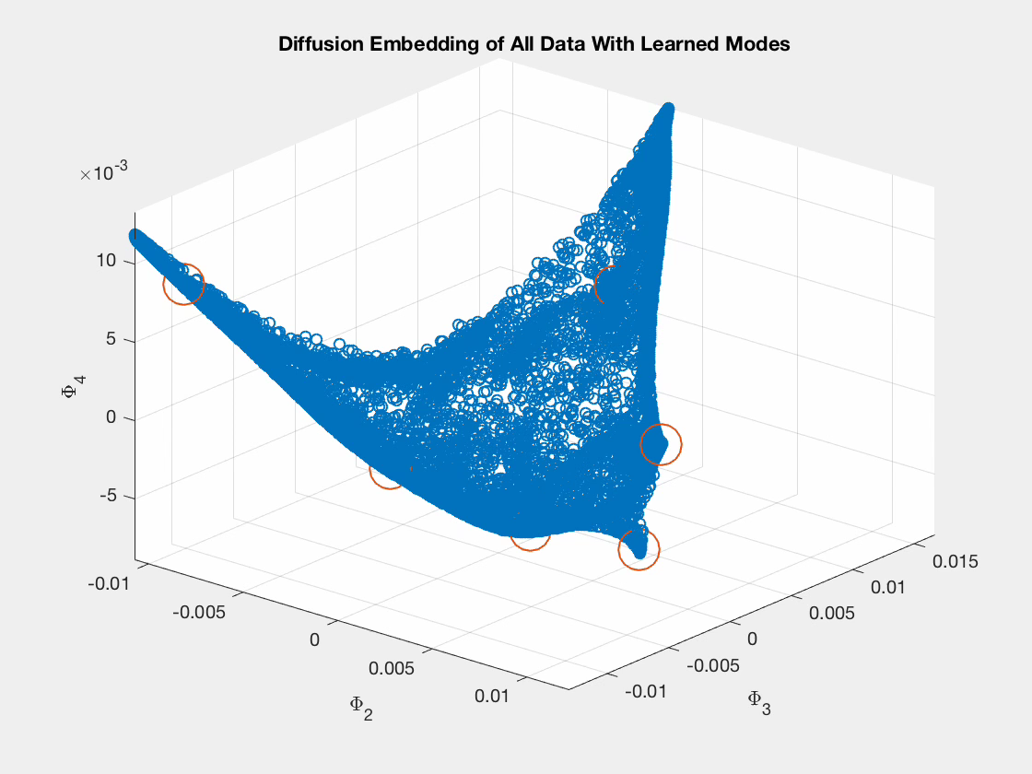
Maximizers of shown in red.

Slide 44


Approach: Density Estimate+Diffusion Geometry
  1.) Mode Estimation: Learn modes of classes by finding high density points that
  are -far from other high density points.
  2.) Spectral labeling: Label points by finding -nearest neighbor of higher density.
  3.) Spatial labeling: Incorporate spatial information for points far from class modes—use spatial regularity to resolve spectral ambiguity.
  Learn the centers of the distributions,
  which we can label confidently.
  Allow these high confidence labels to
  spread their labels to (spectrally) nearby points.
  Intervene near the class boundaries.
Overall complexity:

Slide 45
Spectral Diffusion
Spectral information alone makes some errors…brown, green, and sky blue classes are mixed up somewhat.

Slide 46

The value of spatial information for HSI
Spectral information only…some problems near class boundaries.
Spectral-only labels

Slide 47


Two Stage Labeling
Stage 1: Only label points that can confidently be labeled with spectral information.
Stage 2: Then, use spatial information to help fill in the remaining, spectral ambiguous points.

Slide 48
Empirical Clustering Results
Spectral-Only Overall Accuracy:
Spatial-Spectral Overall Accuracy:
Ground Truth
Compares very well to state-of-the-art….and fast!

Slide 49
Nonparametric Performance Guarantee
If the Markov transition matrix is nearly block diagonal, then the proposed method learns only one mode from each cluster, because the diffusion distances between clusters will be very large.
This leads to guarantees on correct mode detection, which in turn lead to guarantees on clustering accuracy.
Our guarantees hold for clusters sampled from non-uniform densities, including multimodal densities!
M. Maggioni and J.M. Murphy. “Clustering by Unsupervised Geometric Learning of Modes.” Preprint. 2017.

Slide 50
Future Diffusion Learning Research
Build multiscale hierarchies of data based on the time parameter in diffusion distance.
Allow for small user inputs to guide the diffusion process to discover the data in a semi-supervised manor.
Incorporate multiple data sources into the diffusion process (e.g. HSI and LIDAR). Related to data fusion and latent variable learning.
Use other distances instead of diffusion distance. LLPD is a related notion, which considers only the path with minimal maximal edge, whereas diffusion distance considers
all paths.

Slide 51
Summary and Broad Future Directions
The low-dimensional, high noise model allows to prove performance guarantees for clustering algorithms.
Efficient algorithms for data-dependent metrics allow to handle large numbers of data points in high dimensions.
Applicable to real-world data, including remotely sensed and medical data.
Future:
Mathematics: Investigate problems in discrete-to-continuum limits, multiscale hierarchies, metrics for graph construction, directed graphs…
Computer Science: Incorporate state-of-the-art computer science structures to improve algorithmic runtime and accuracy.
Data Science and Interdisciplinary Collaboration: Develop algorithms and software for application to real data: remote sensing, medical signals, social media networks…

Slide 52
Thank You!
Papers and code: http://www.math.jhu.edu/~jmurphy/
Contact: James M. Murphy, jmurphy@math.jhu.edu

